Slide 1



Adaptive Cards
Community call
Adaptive Cards Host Control in Microsoft PnP Library 👀
Designer Device Emulator 🆕
Q&A ❔
Fabio Franzini Microsoft MVP
Will Shown Microsoft
J.P. Roca Microsoft
March 10, 2022

Slide 2
Adaptive Cards Host Control in Microsoft PnP Library
Notes:
I wanted to give you all a recap on Viva Connections, and how the Adaptive Card framework plays a big role in the extensibility world of Viva Connections, for both 1P and 3P components and how the devs can use that to extend VC experience in the dashboard.

Slide 3
Agenda
Understanding the reasons behind the implementation of this control
Why I chose to use the Adaptive Cards SDK
Introduction to the control, how it was implemented and how to use it in SPFx
Demo
What's next steps?
References

Slide 4
Understanding the reasons behind the implementation of this control
Very often, in my development activities, customers ask me SPFx customizations with identical functionality, but which may differ for the UI part.
This led me to think of a way to have the ability to "change" the UI at runtime, without having to recompile the SPFx solution.
After several attempts and reasoning, the choice fell on Adaptive Cards.

Slide 5
Why I chose to use the Adaptive Cards SDK
Because… 😀
Adaptive Cards are platform-agnostic snippets of UI, authored in JSON, that apps and services can openly exchange. When delivered to a specific app, the JSON is transformed into native UI that automatically adapts to its surroundings. It helps design and integrate light-weight UI for all major platforms and frameworks.
The goals for Adaptive Cards are:
Portable - To any app, device, and UI framework
Open - Libraries and schema are open source and shared
Low cost - Easy to define, easy to consume
Expressive - Targeted at the long tail of content that developers want to produce
Purely declarative - No code is needed or allowed
Automatically styled - To the Host application UX and brand guidelines

Slide 6
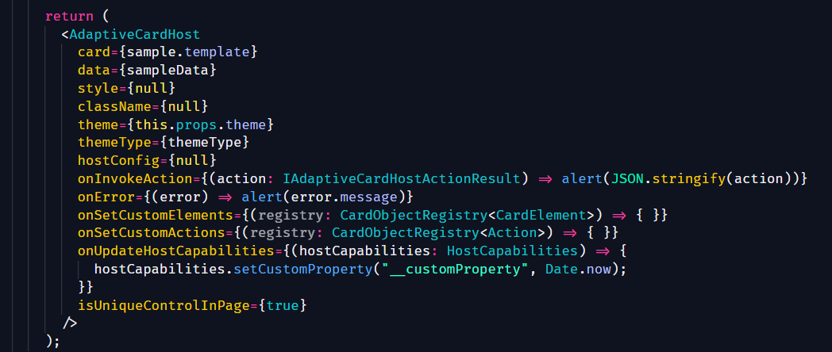
Introduction to the control, how it was implemented and how to use it in SPFx
React Control that render Adaptive Card using the SDK
Using a brand-new Fluent UI Elements that use the Fluent UI Theme both for SharePoint and Microsoft Teams
Auto apply the AC Template if data object is passed to the control
Callbacks to intercept Actions and Errors
Callbacks to set custom Elements and custom Actions
Callback to set custom Host Capability properties

Slide 7
Demo
Web Part in SharePoint
Web Part as Teams Tab

Slide 8
What's next steps?
Implement the Designer component for the PnP Reusable React Controls Library
Create a set of new Adaptive Cards elements (targeted only for Js SDK):
Maybe using Fluent UI React 🙂
Maybe using Fluent UI Web Components 🙂
Maybe using MGT (Thanks to Joao Mendes) 🙂
Maybe using another libraries…

Slide 9
References
AdaptiveCardHost - @pnp/spfx-controls-react: https://pnp.github.io/sp-dev-fx-controls-react/controls/AdaptiveCardHost/
Demo (Will be avaible here): http://aka.ms/spfx-webparts

Slide 10

About Me
CEO Apvee Solutions, Microsoft MVP in Business Applications & Office Development categories.
📧 fabio@fabiofranzini.com
💻 http://fabiofranzini.com/
🐥@franzinifabio
🧑🏽‍💼@fabiofranzini

Slide 11
New Designer Device Emulator
Notes:
I wanted to give you all a recap on Viva Connections, and how the Adaptive Card framework plays a big role in the extensibility world of Viva Connections, for both 1P and 3P components and how the devs can use that to extend VC experience in the dashboard.

Slide 12
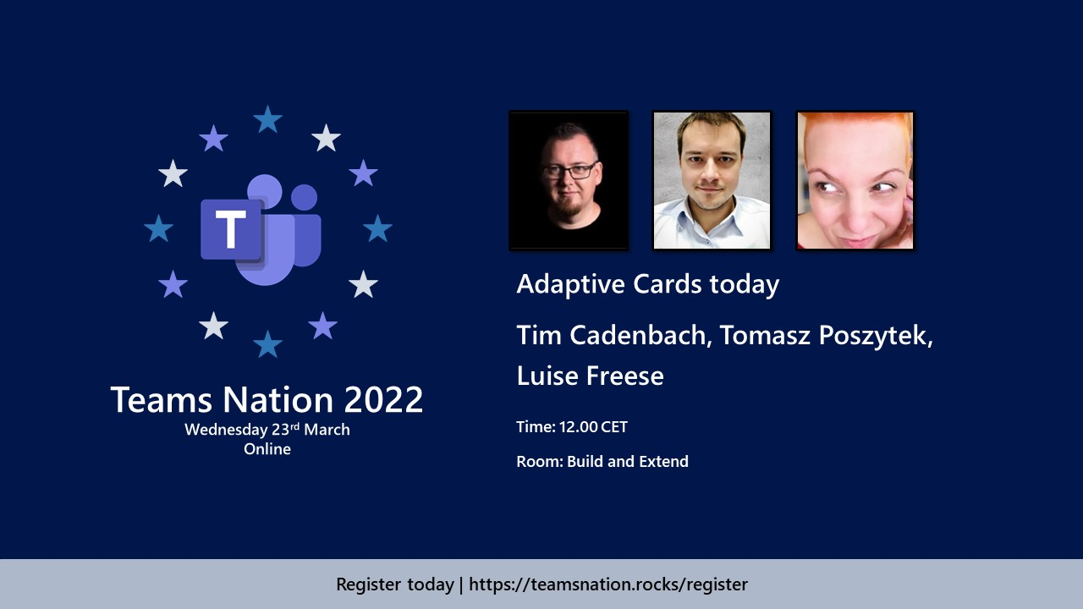
Notes:
I wanted to give you all a recap on Viva Connections, and how the Adaptive Card framework plays a big role in the extensibility world of Viva Connections, for both 1P and 3P components and how the devs can use that to extend VC experience in the dashboard.

Slide 13
Q&A

Slide 14
Resources
Let us know the features you need https://aka.ms/ACRoadmap
Get started with Templating https://aka.ms/ACTemplating
Browse the Adaptive Cards Code https://aka.ms/ACRepo
Find tools, sample cards and more https://www.madewithcards.io

Slide 15
Microsoft 365 developer community calls
Microsoft 365 platform call (weekly) https://aka.ms/m365-dev-call
Adaptive Cards (monthly) https://aka.ms/adaptivecardscommunitycall
Microsoft identity platform (monthly) https://aka.ms/IDDevCommunityCalendar
Office Add-ins (monthly) https://aka.ms/officeaddinscommunitycall
Power Apps (monthly) https://aka.ms/PowerAppsMonthlyCall
Microsoft 365 Community (bi-weekly) https://aka.ms/m365-dev-sig
SharePoint Framework (bi-weekly) https://aka.ms/spdev-spfx-call
https://aka.ms/m365pnp

